Slide 1
WithU
Sam Patterson, Joshua Chaimson, Pritesh Kalantri, Will Roberts, Mingren Shen, Shantanu Singhal, Jason Waner

Slide 2

Project Abstract
WithU provides UW Madison students the ease of mind when walking home alone.
Simply request a pair of walkers, and they will see you to your destination.

Slide 3
Specifications
User signup and login
User selects their current location and destination to walk to on a map
Two walker users get paired up to create one group
User can request a pair of walkers to walk them to their desired location
Turn by turn directions shown to the walkers

Slide 4
Design
Android Studio
Google Firebase
Authentication
Real-time Database
Cloud Storage
Google Maps API
Large map UI
Functionality
Create path from one point to another
Estimate time to destination
Convert longitude and latitude into nearest address

Slide 5
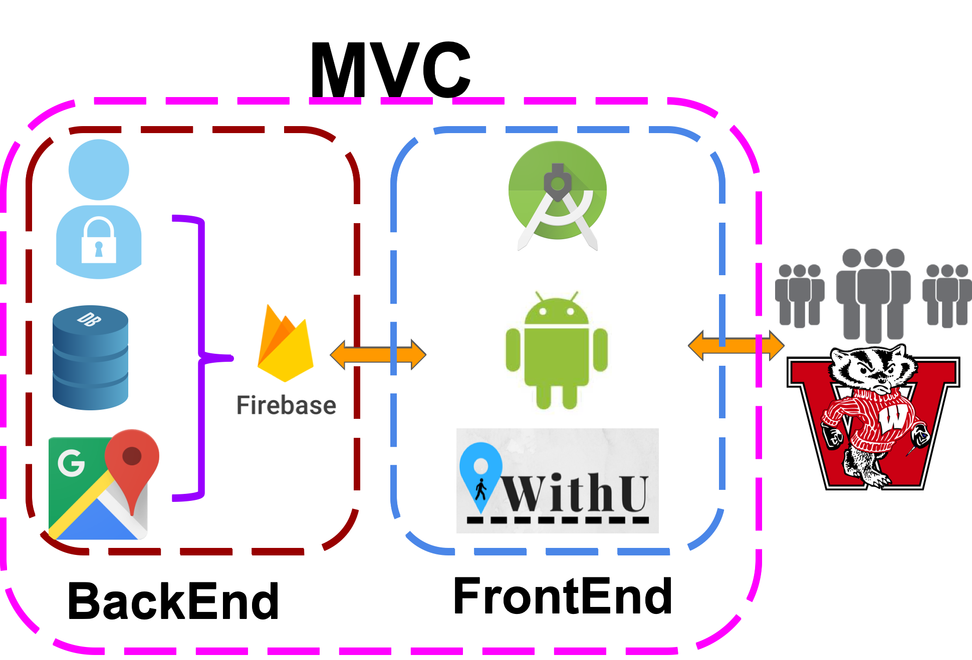
Design (continued)

Slide 6
Accomplishments
User and Walker Sign In / Sign Up
User functionality
Walk Request
Walk Directions
Calling walkers
Partial Walker functionality
Calling the requestor
Walk Directions
Walk path displayed on map
Notifications when the walk begins, ends

Slide 7
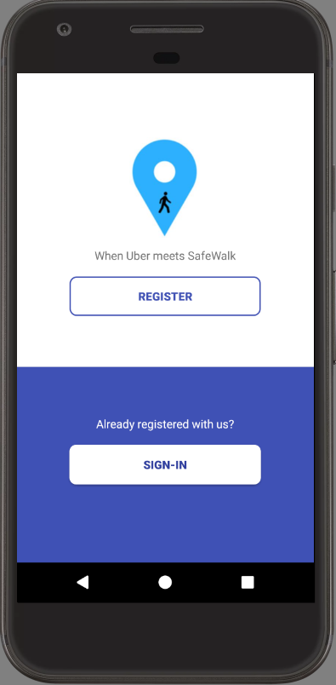
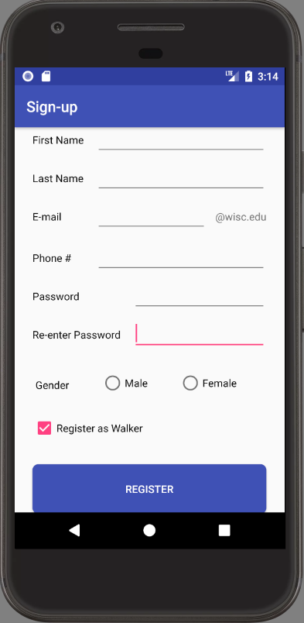
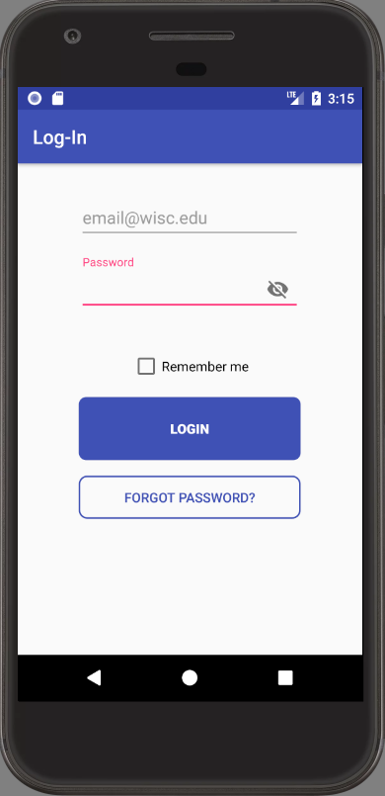
Sign In / Sign Up

Slide 8
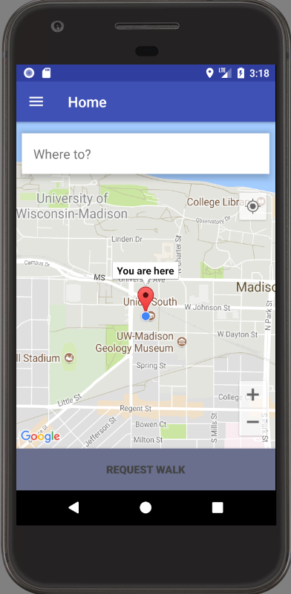
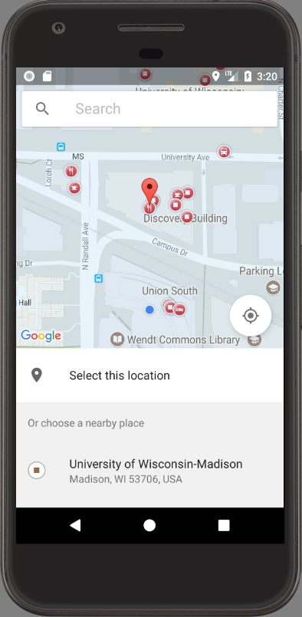
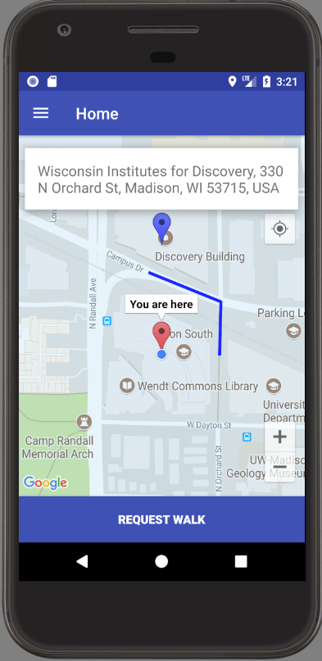
Requesting Walkers

Slide 9

Not Accomplished
Walker Pairing
Full Walk Flow
Rating Walkers

Slide 10
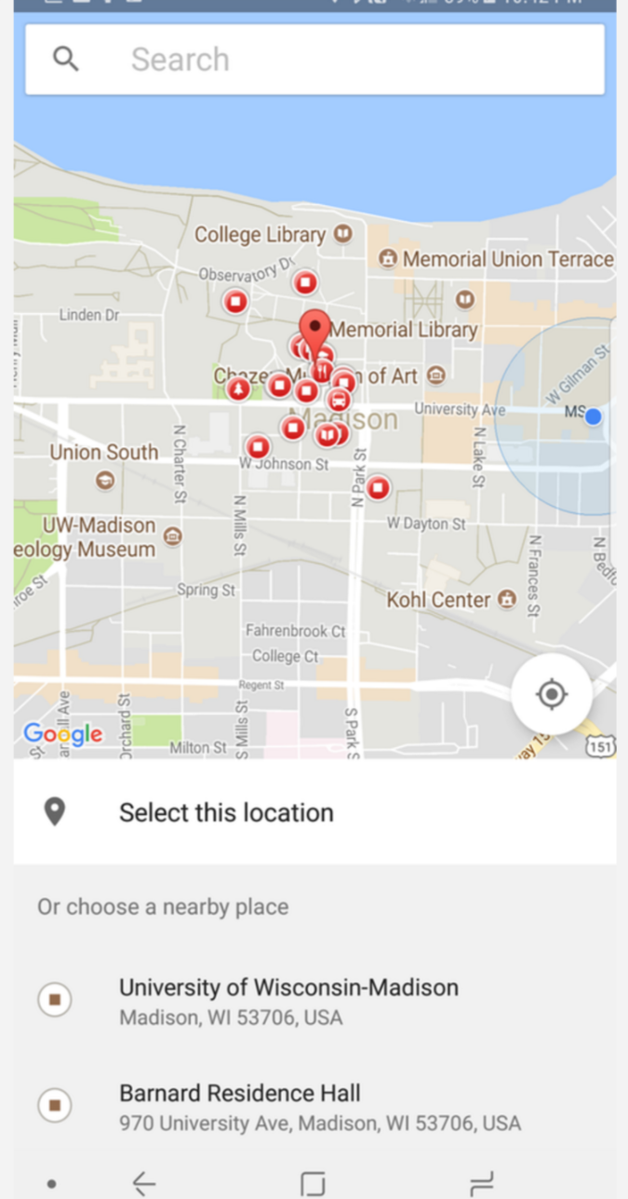
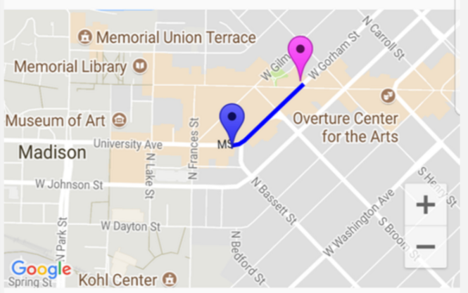
Difficulties
Firebase synchronization
Trying to design with the user in mind
Activity flows, popups, etc.
Integrating Google maps/places API
Adding a route to our map

Slide 11
Lessons Learned
Extreme programming is extremely difficult
Strong design prior to coding is critical
Design teams around features rather than just front end / back end

Slide 12


